Slide 1


Focus Web Developer
Week 2 – Lesson 3
Notes:
Welcome your class, think about what is the hook to engage your students right out of the starting gate.

Slide 2
Lesson Topics
HTML 5 & CSS3 Practice Continued
Notes:
Pre-test
Two-way learning

Slide 3
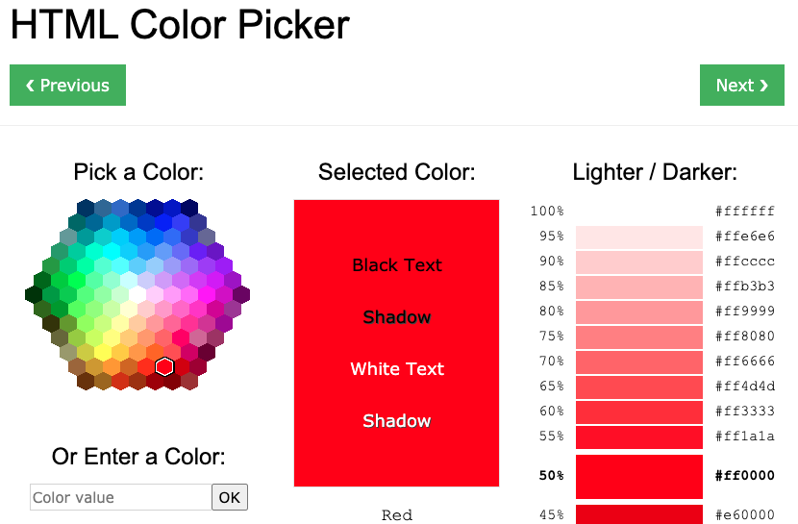
Quick tip!
Bookmark this URL: https://www.w3schools.com/colors/colors_picker.asp
You can get what colour you want in multiple formats!

Slide 4
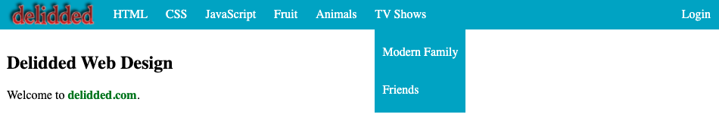
Activity 2 Introduction
Copy your code from Activity 1 and modify it to make dropdown menus
these are all dropdown menus that appear when hovered over
Functional Example:
https://nick-adamson.github.io/Activity-1/
Activity 1 is from https://www.delidded.com/html-css-practice-test/html-css-practice-problems/

Slide 5
Activity 2 Introduction
3. specifically, it is nested within this list item
2. that is nested within this unordered list
1. this is an unordered list
Activity 1 is from https://www.delidded.com/html-css-practice-test/html-css-practice-problems/

Slide 6
Activity 2 Introduction
Requirements:
Create a similar webpage with dropdown menu items
Duplicate your code from Week 2 Day 3 Activity 1
Use <title>Week 2 Day 3 Activity 1</title> in the head
Create three more menu items at the top all with at least two dropdown links that appear only when they are hovered over (it doesn’t matter what they are)
Make the dropdown links navigate to pages of your choice in the same tab
Activity 1 is from https://www.delidded.com/html-css-practice-test/html-css-practice-problems/

Slide 7
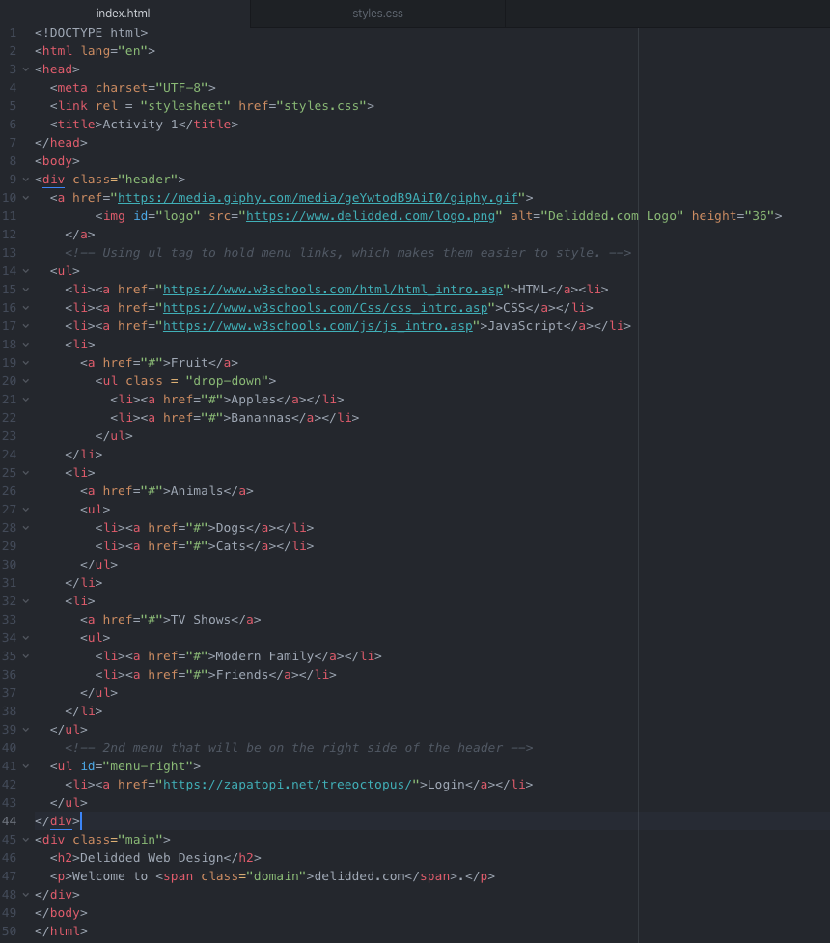
Activity 2 Solution (HTML)
Activity 2 is from https://www.delidded.com/html-css-practice-test/html-css-practice-problems/

Slide 8
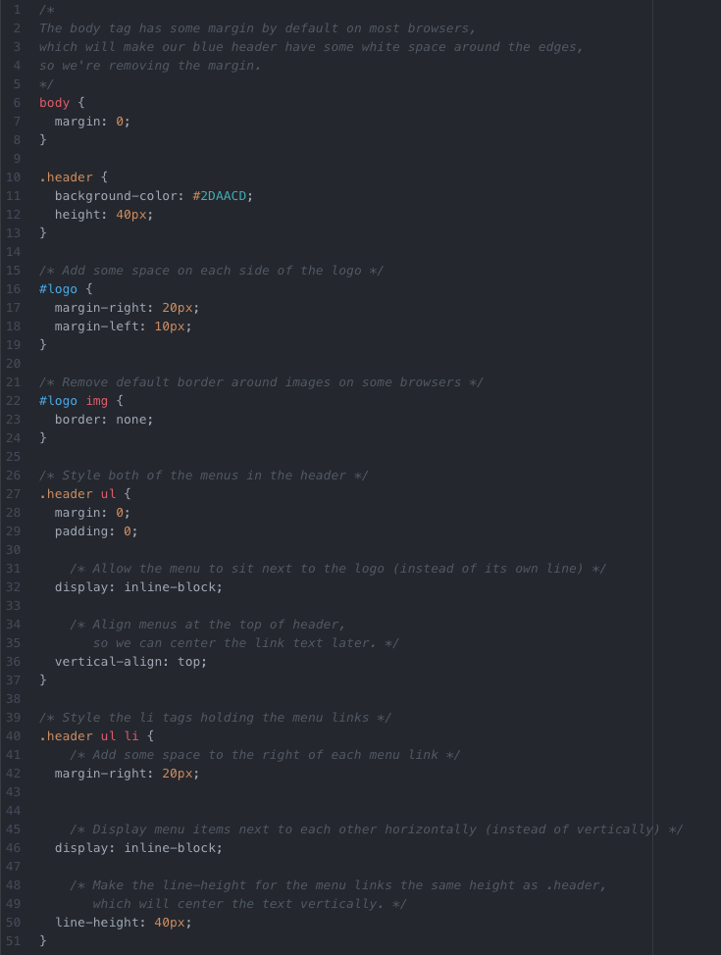
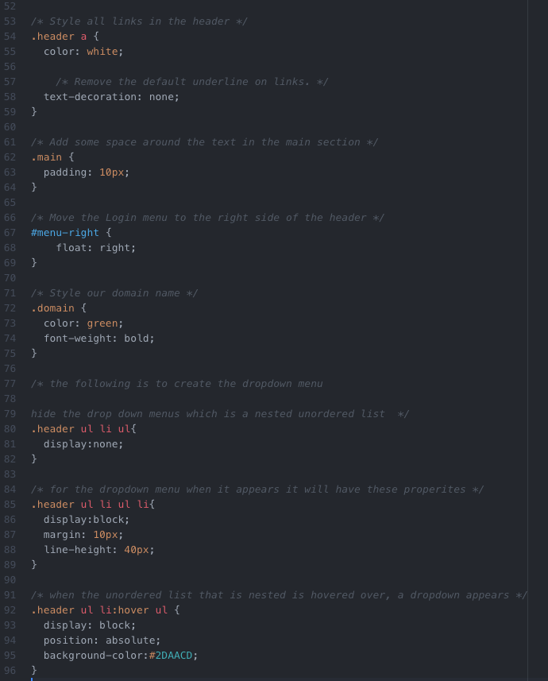
Activity 2 Solution (CSS)
Activity 2 is from https://www.delidded.com/html-css-practice-test/html-css-practice-problems/

Slide 9
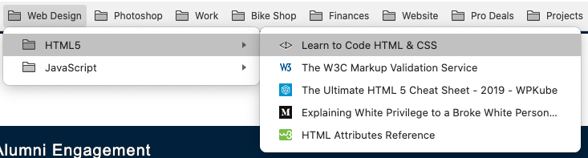
Activity 2 Challenge
Once you have checked your code with your partner, try the challenge.
Duplicate your index.html file from Activity 2 into a new folder named “Activity 2 Challenge”
Challenges:
from your dropdown list, create another “dropdown” list that opens sideways
Activity 2 is from https://www.delidded.com/html-css-practice-test/html-css-practice-problems/

Slide 10
Gathering Time
Gathering Time is a time for check-in.
Notes:
Instructors Notes:
Introduce the concept of Gathering Time, which will be used throughout the program.
The sharing stone can be just a stone someone in the class wants to use or one from outside.
It just reminds everyone to listen when the person with the stone talks, so everyone has an opportunity to listen.
Chairs only
Someone from the host Nation can be offered to start the check-in first. If no one is interested then someone else in the group, or the Instructor, will be offered to start it next.

Slide 11
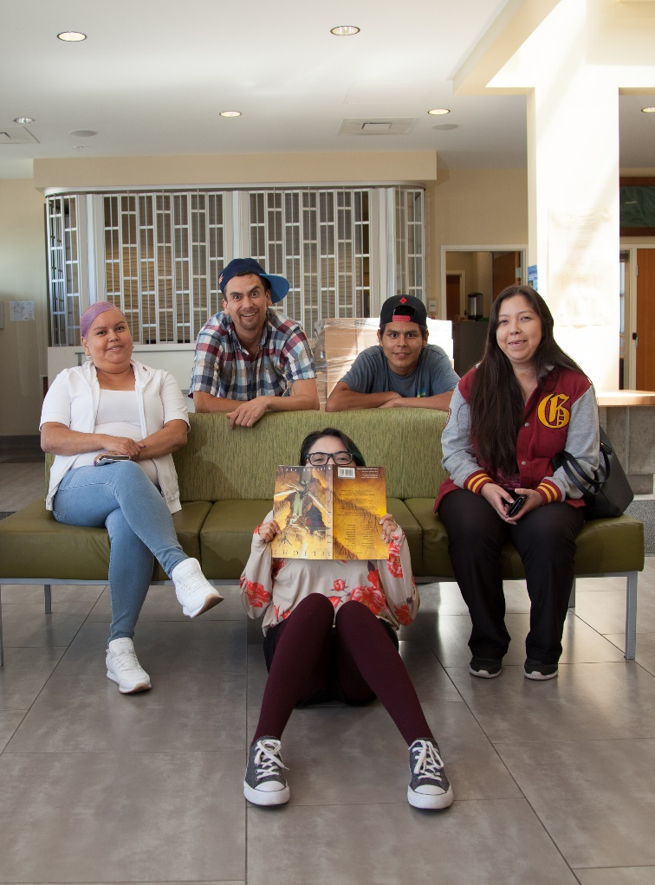
Class Wrap-up
How was your day?
How’s your website coming along?
Are you excited to add some colour?
Notes:
Post test: provide the students with feedback about the day, review the day.
End of the day Q/A
Were the day’s goals met (reference slide 2)?
Transition: what’s coming up tomorrow?

